Slide 1
Instahyre Job Analytics and
Job Finder
Creating a Website using Instahyre Data
Project Submitted by: Anmol Kumar | Babli Kumari | Minal Jain | Snigdha Verma

Slide 2

Objective
To scrap the jobs data from a job searching website - Instahyre.
To perform necessary EDA on this data and draw some meaningful key insights.
To create a Machine Learning Model which takes keywords (job roles/skills/locations) from users and show them most relevant results related to their job finding criterias.
Also provide some key insights to the user related to their search.

Slide 3
Web Scrapping
Utilized the power of Python’s libraries to extract the required data from Instahyre.
Primary tools – BeautifulSoup and Selenium.
Successfully extracted all required features
Extracted 850+ records
Exceptional Handling

Slide 4
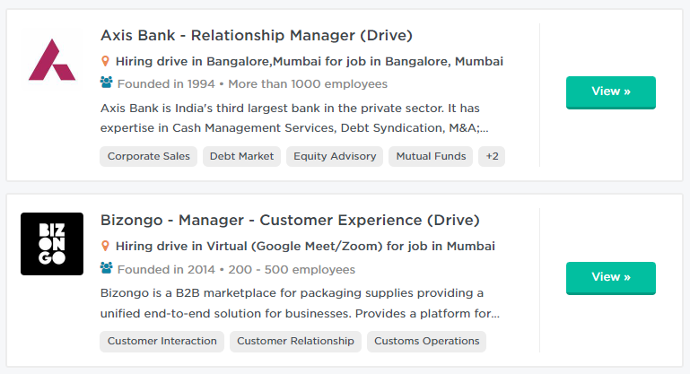

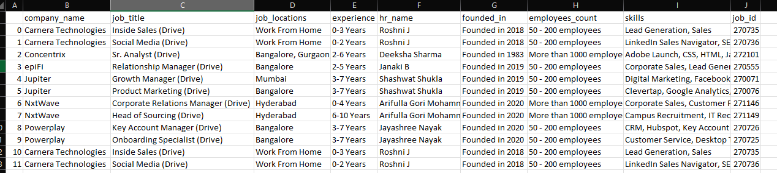
Web Scrapping

Slide 5
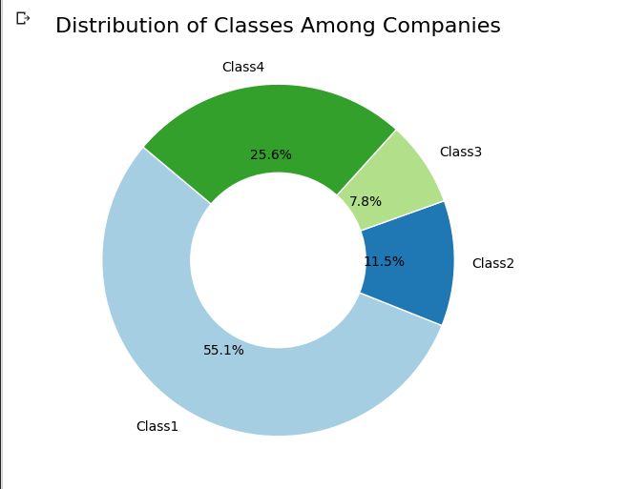
Class Distrubution
Feature – count of Employees
Build a K-means Clustering Model
Class1 Category: Least employee count
Class4 Category: Highest employee count

Slide 6
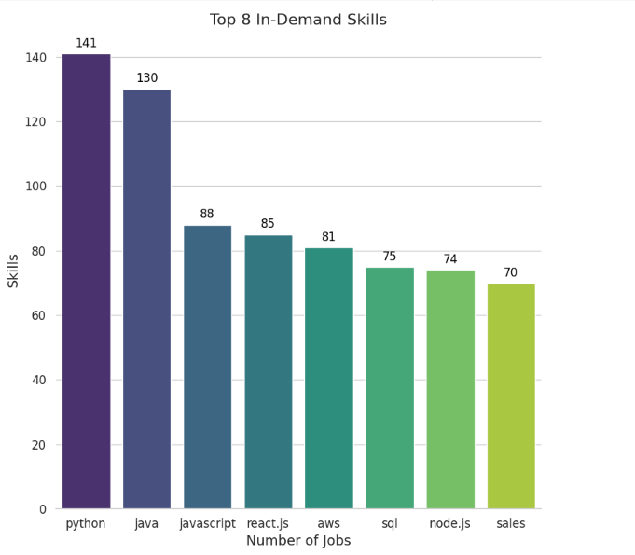
Insights
Top 8 In-Demand Skills

Slide 7
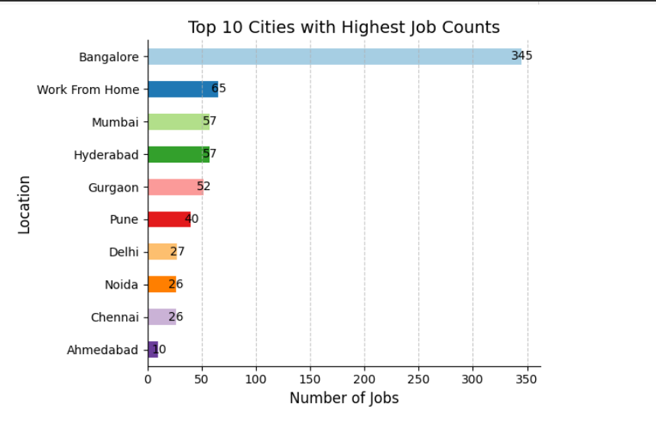
Insights
Top 10 Dominating Cities

Slide 8
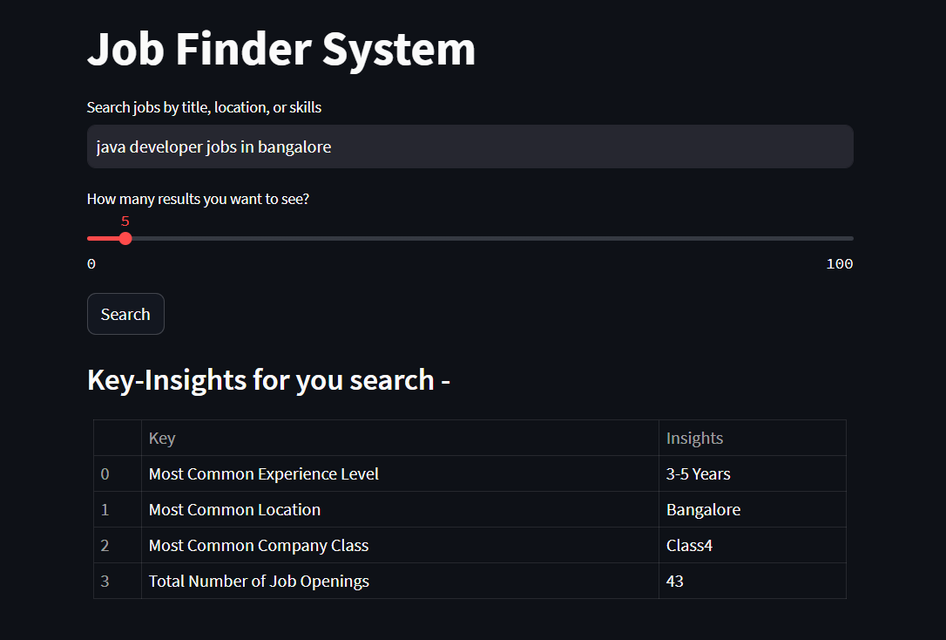
Model Features
A user can search jobs by skills, locations, or by job titles, or even a combination of three all.
User can also control how many top similar results he wants using a dedicated slide bar
First user gets the insights from current market related to his search

Slide 9
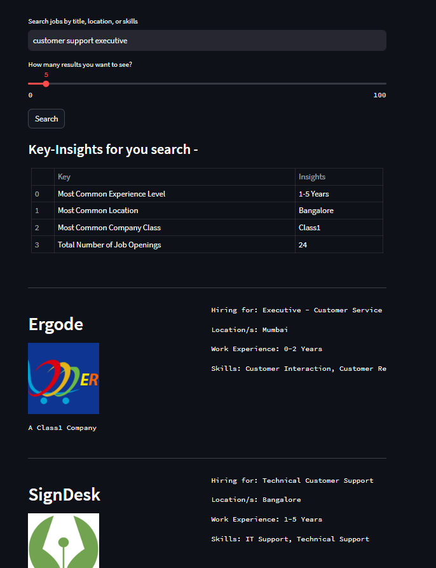
User will get job recommendations based on keywords entered and similarity in descending order
User can see the company logo along with company name, class, experience required and skills.

Slide 10
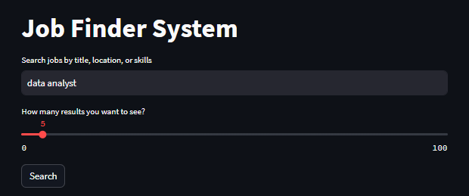
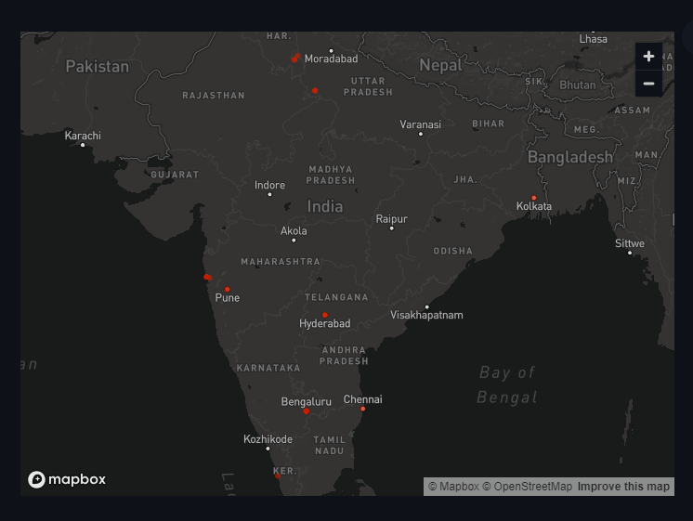
User is able to see job openings location in a single view also with the help of a map

Slide 11
Challenges
Data Scrapping
Choosing best libraries for model
Creating frontend

Slide 12

Tools Used

Slide 13

Thanks!

